Slide 1
Blogging in the classroom
Melanie Hosbach
Lapeer Community Schools

Slide 2
Blogging? What’s a blog?
(insert survey info here)
Short for “Web Log”
Online journal…and more!
Links
Pictures
Documents
Informal
Interactive
Comments
http://www.youtube.com/watch?v=NN2I1pWXjXI

Slide 3
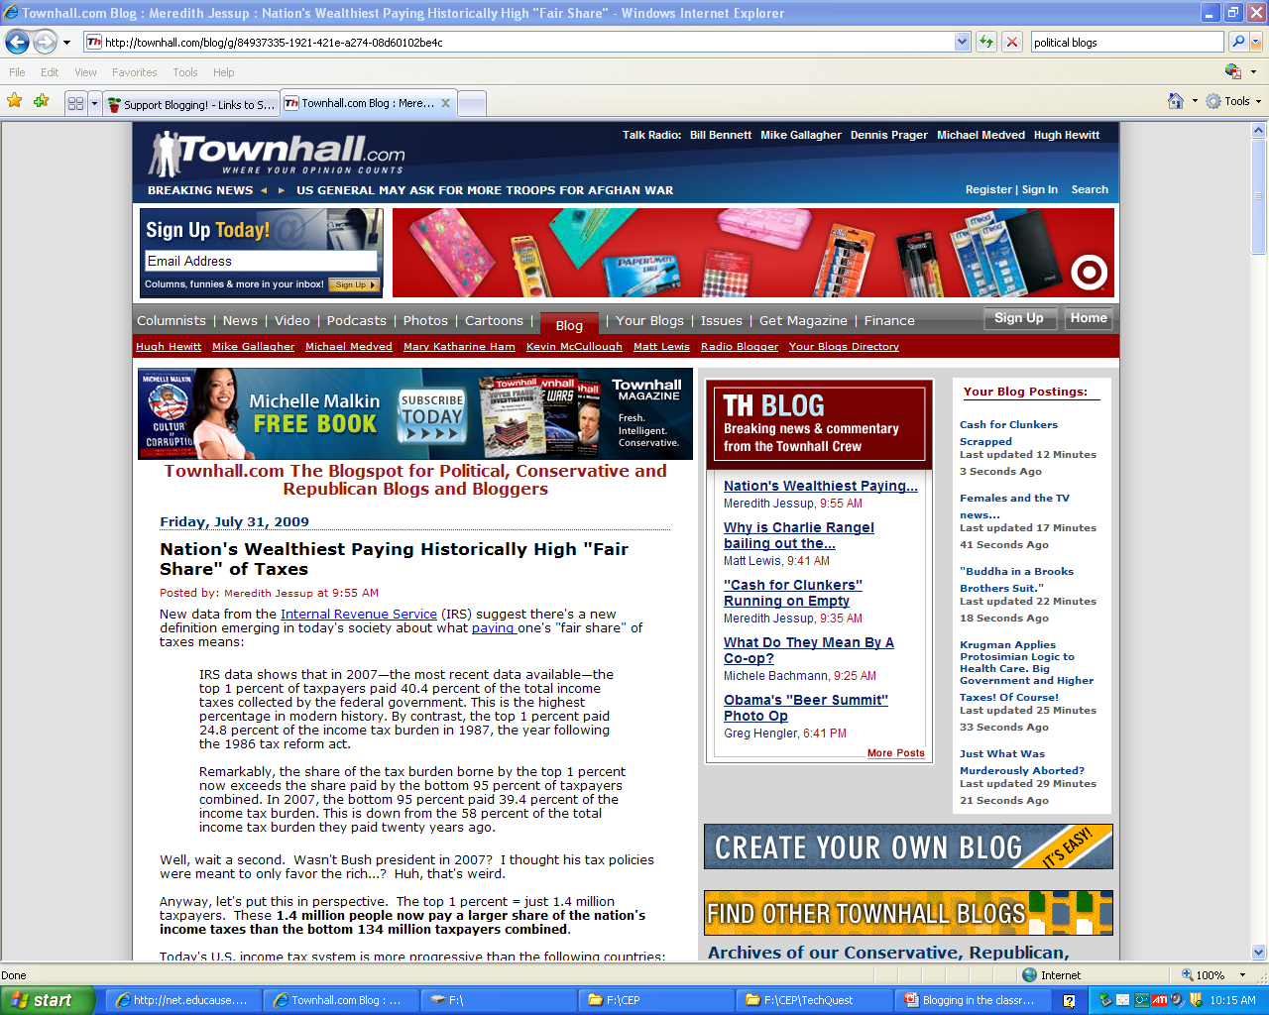
Who uses blogs?
Topic specific
Politics
Current Events

Slide 4
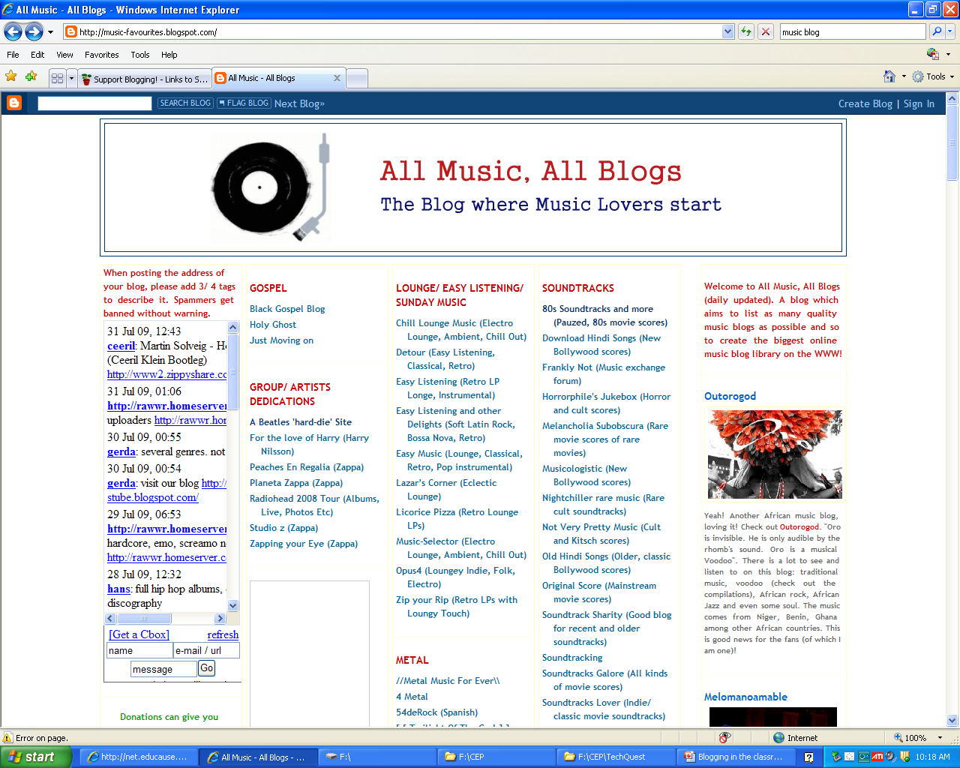
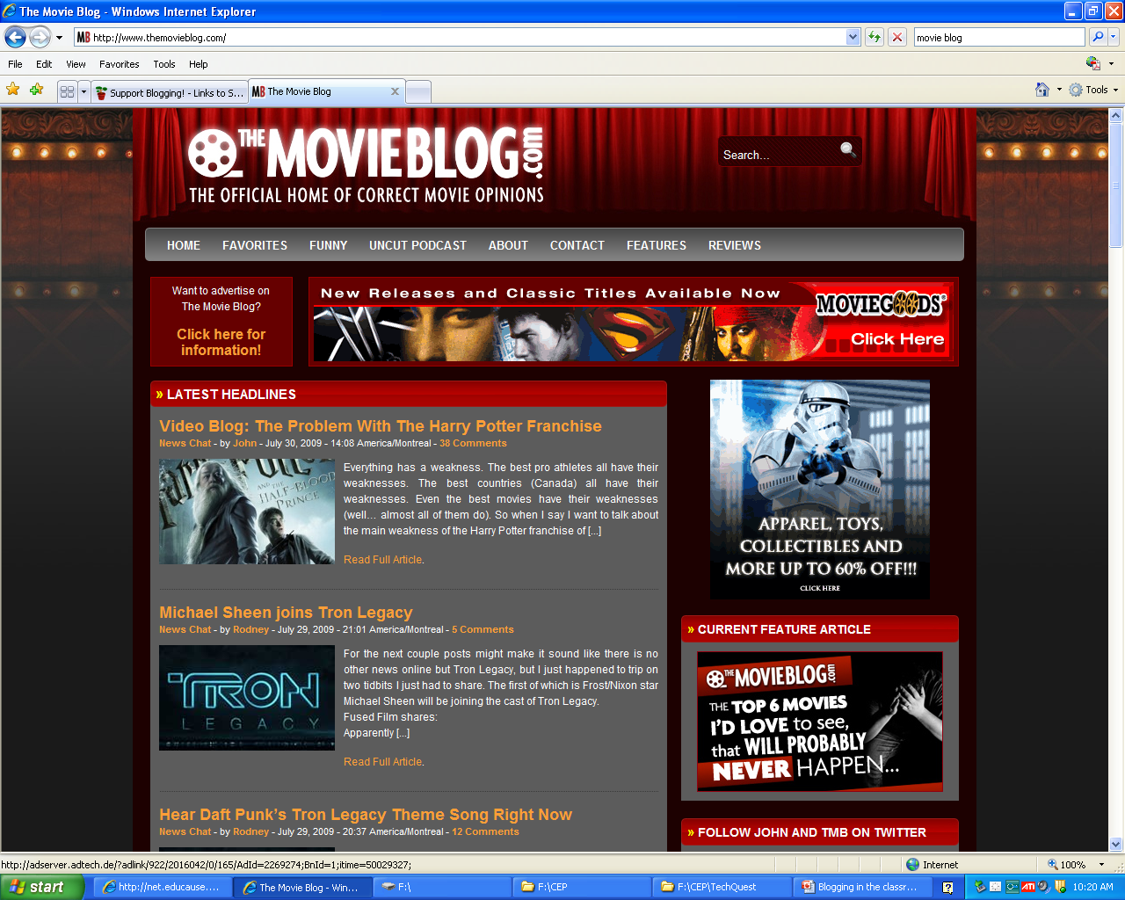
Who uses blogs?
Topic specific
Music
Movies

Slide 5
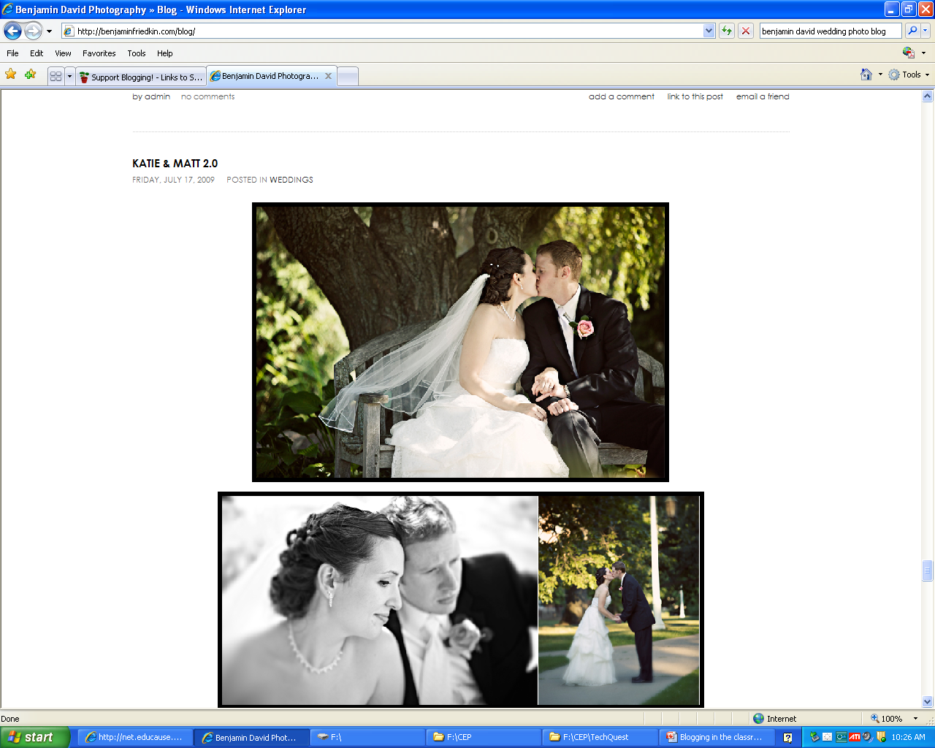
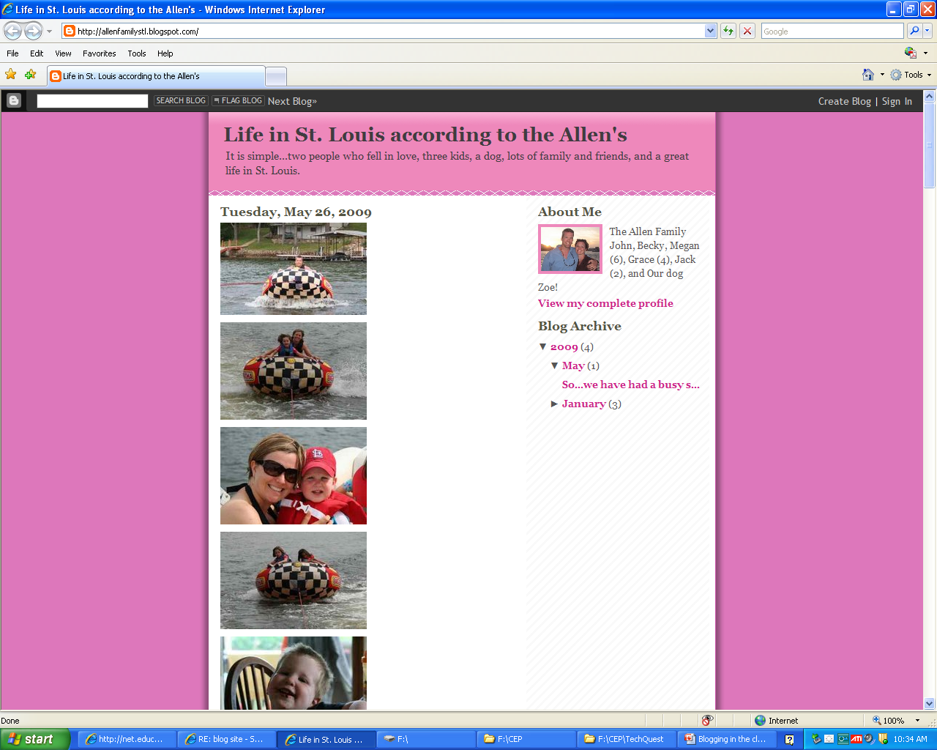
Who uses blogs?
Personal sharing
Photos
Event Information
Family Updates

Slide 6
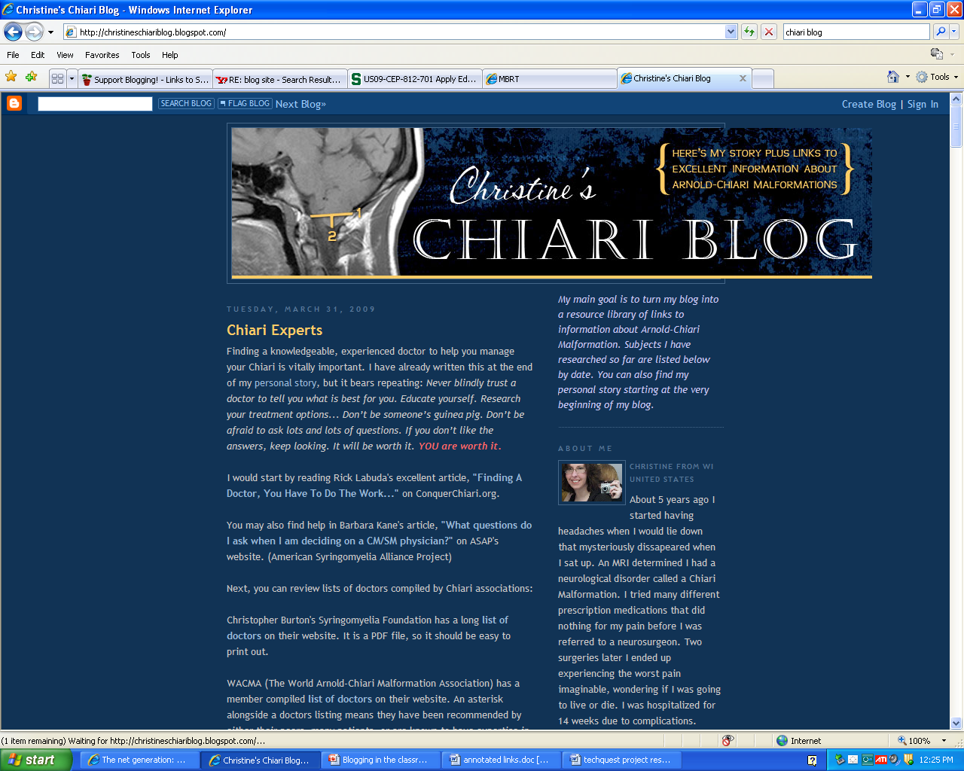
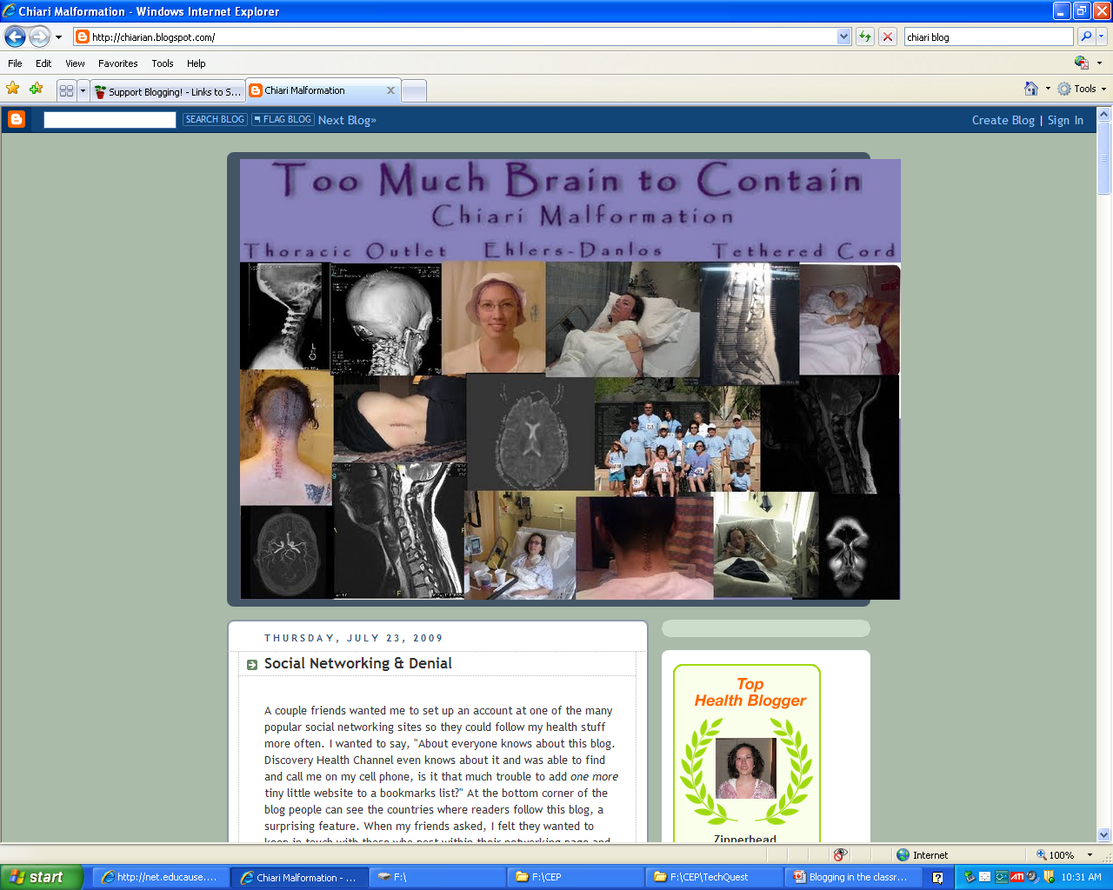
Who uses blogs?
Personal sharing
Medical updates

Slide 7
Why is blogging and other technology important?
“Net generation”
According to a survey of over 7,000 college students from 7 different schools across the country*:
Ninety-seven percent own a computer, 94 percent own a cell phone, and 56 percent own an mp3 player.
Seventy-six percent of students use Instant Messaging.
IM users typically chat 80 minutes per day.
Ninety-two percent of IM users reported doing something else on the computer while IM-ing.
Twenty-eight percent reported owning a blog and 44 percent reported reading blogs.
Interactivity
Global Access
*Connecting to the Net Generation: What Higher Education Professionals Need to Know about Today's Students. By Dr. Reynol Junco, NCC, LPC and Dr. Jeanna Mastrodicasa

Slide 8
Educational benefits of blogs
According to Glencoe’s “Teaching Today”* tips page, blogs are
motivating to students, especially those who otherwise might not become participants in classrooms.
excellent opportunities for students to read and write.
effective forums for collaboration and discussion.
powerful tools to enable scaffolded learning or mentoring to occur.
*http://teachingtoday.glencoe.com/howtoarticles/blog-basics

Slide 9
How can I use a blog in my classroom?
Information sharing
Calendar
Assignments
Updates
Discussion board
Recorded for future
Introverts won’t feel as threatened
Provides time for thought process
Venue for collaboration
Group projects
Peer review
Student portfolios
File storage and sharing
http://www.youtube.com/watch?v=whm3pxqkvB8

Slide 10
resources
Web 2.0 Tutorial http://web2tutorial.wikispaces.com/
A tutorial for educators done as a wiki to explain and give examples of various Web 2.0 technologies such as blogs, wikis, social networking, RSS feeds, etc.
Classroom 2.0 http://www.classroom20.com/
“Classroom 2.0” is a social networking site for educators to introduce and explain various Web 2.0 technologies.
“Teachers First: Blog Basics for the Classroom” http://www.teachersfirst.com/content/blog/blogbasics.cfm
This site introduces the basics of blogging and how it can be useful in the classroom. It explains what a blog is, how to use a blog, and gives multiple examples of how to use a classroom blog.
Glencoe McGraw-Hill’s “Teaching Today: Teaching Tips, Lesson Plans, & More” http://teachingtoday.glencoe.com/howtoarticles/blog-basics
This textbook publisher’s site for teachers includes various tips and strategies for all different subject areas and grade levels. This article specifically explains the basics of blogging and how to use blogs in the classroom.
Blogs on Educational Blogging http://supportblogging.com/Links+to+School+Bloggers
Site that lists many different examples of classroom blogs, student blogs, teacher blogs, etc.

